Slide 1
Metagenome-assembled genomes from a population-based cohort uncover novel gut species and strain diversity, revealing prevalent disease associations
Kateryna Pantiukh, Kertu Liis Krigul, Oliver Aasmets, Elin Org
Institute of Genomics, Estonian Genome Centre, University of Tartu, Tartu, Estonia

Slide 2
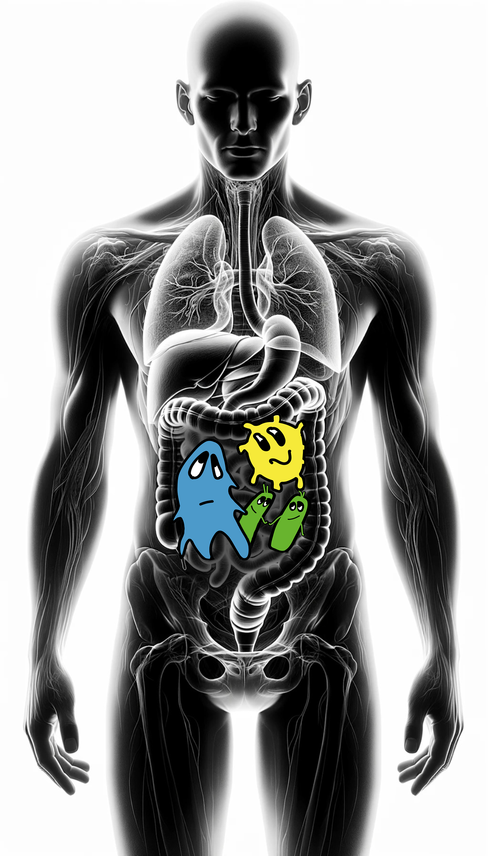
Estonian Microbiome Cohort
2,500 human gut microbiome samples
2nd TP for 332 samples

Slide 3
Estonian Microbiome Cohort
2,500 human gut microbiome samples
2nd TP for 332 samples

Slide 4
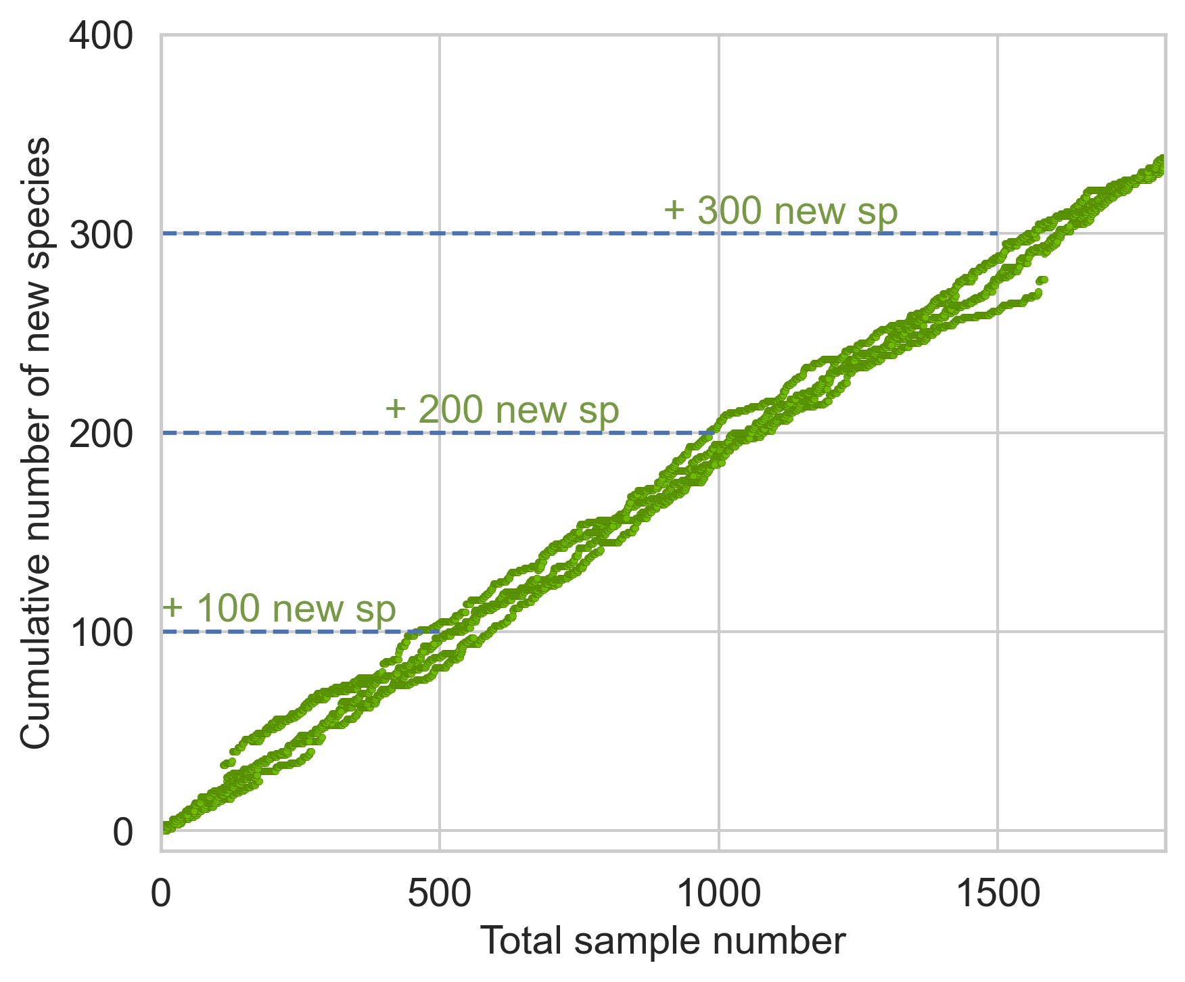
Estonian Microbiome Cohort
2,500 human gut microbiome samples
2nd TP for 332 samples
Many gut bacteria are missing from databases
Bacterial species form a continuum, not strict groups

Slide 5
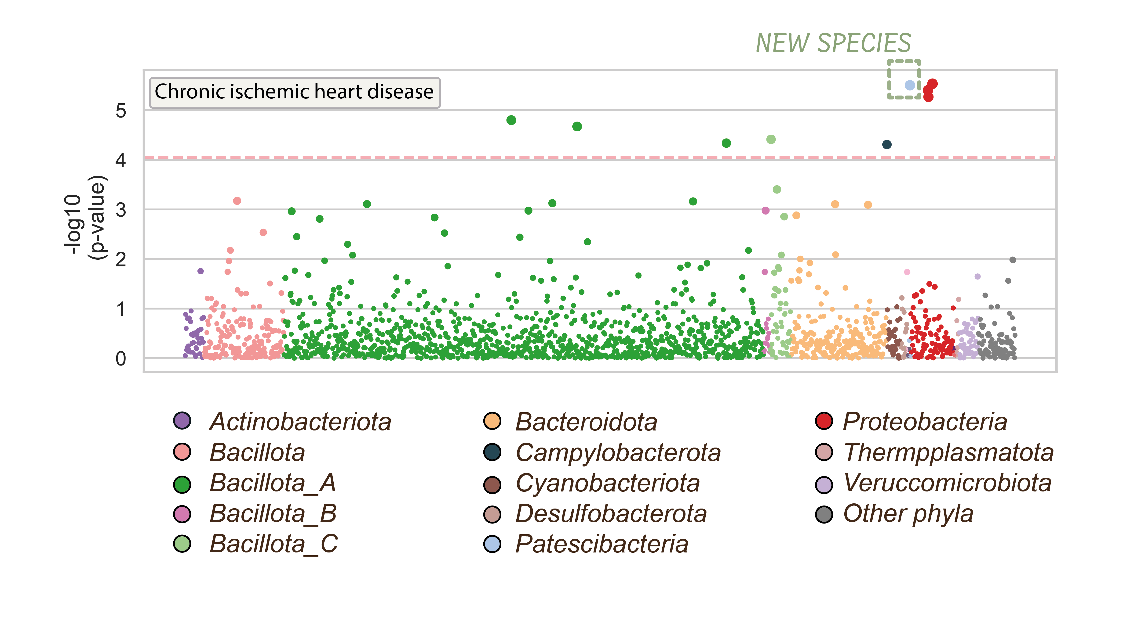
Association study on species level
84,254 MAGs
2,257 species
353 new species
Many gut bacteria are missing from databases
Bacterial species form a continuum, not strict groups
33 diseases analysed
Species-level associations identified in 25 diseases
9 diseases showed links to newly discovered species

Slide 6
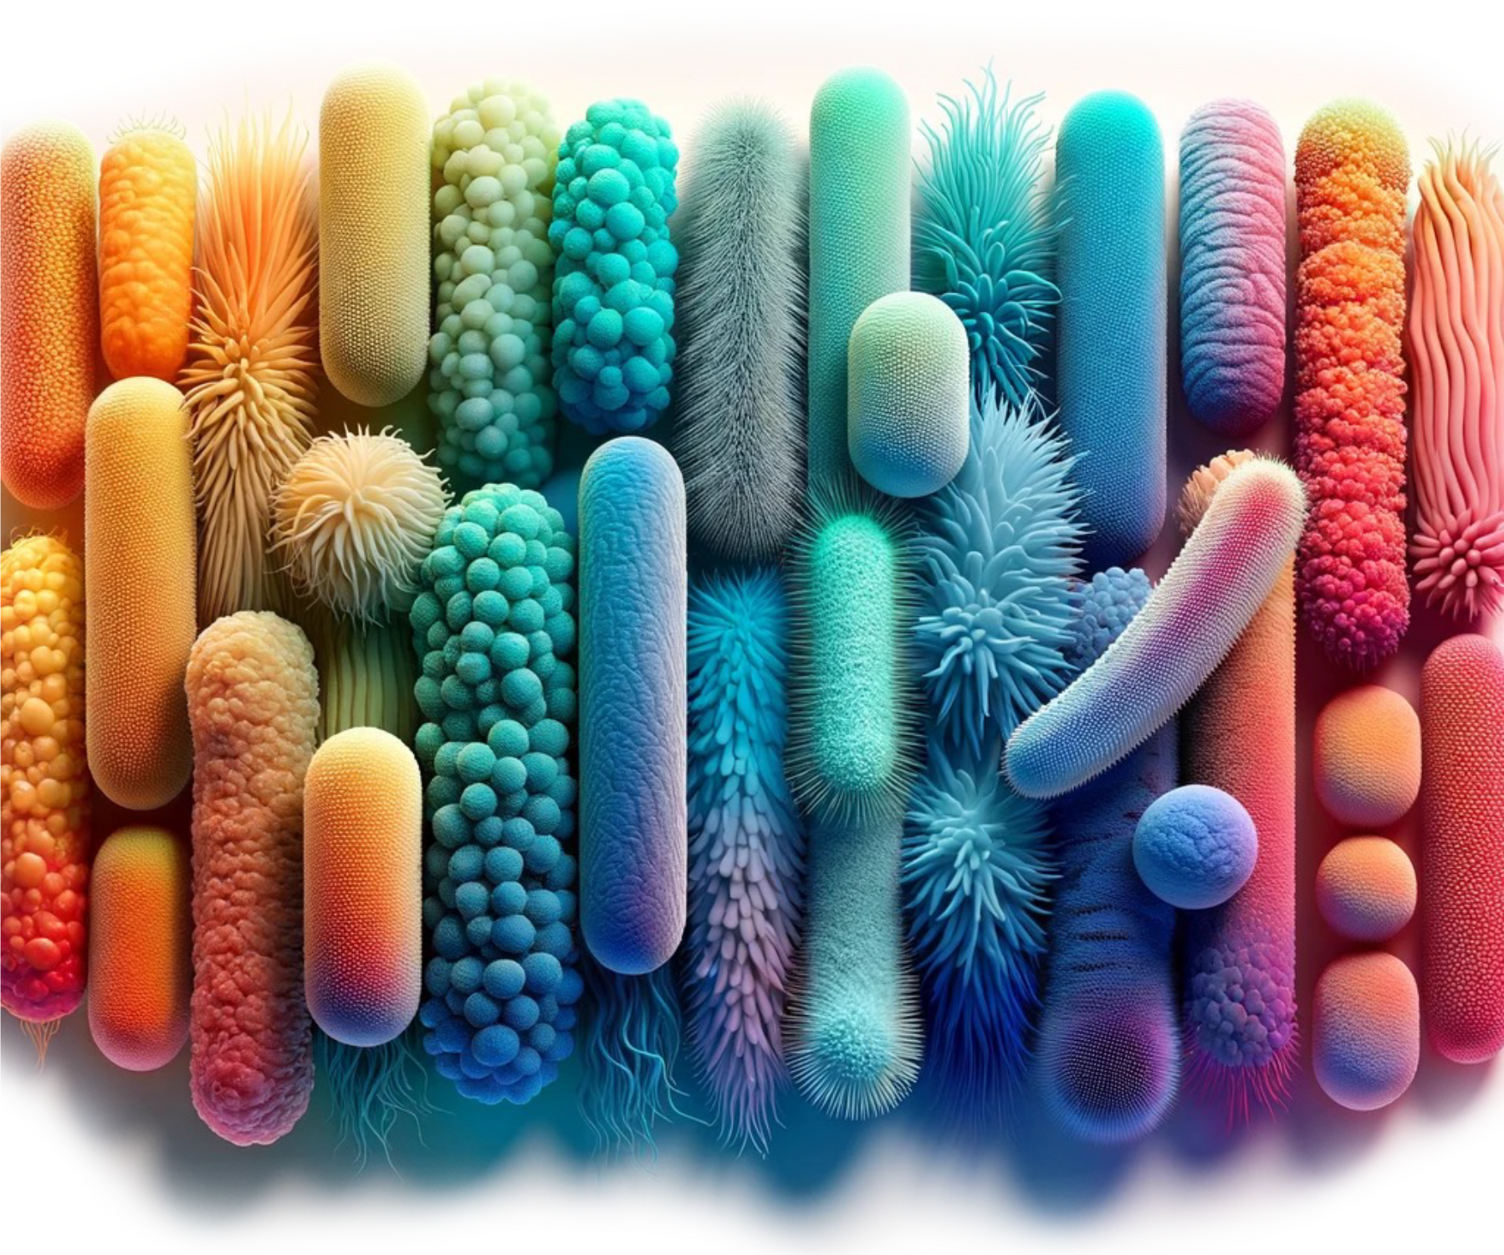
When species is just not enough
84,254 MAGs
2,257 species
353 new species
33 diseases analysed
Species-level associations identified in 25 diseases
9 diseases showed links to newly discovered species
Bacteria with
genome similarity > 95%
are different species
Species 1
Species 2
Species 3

Slide 7
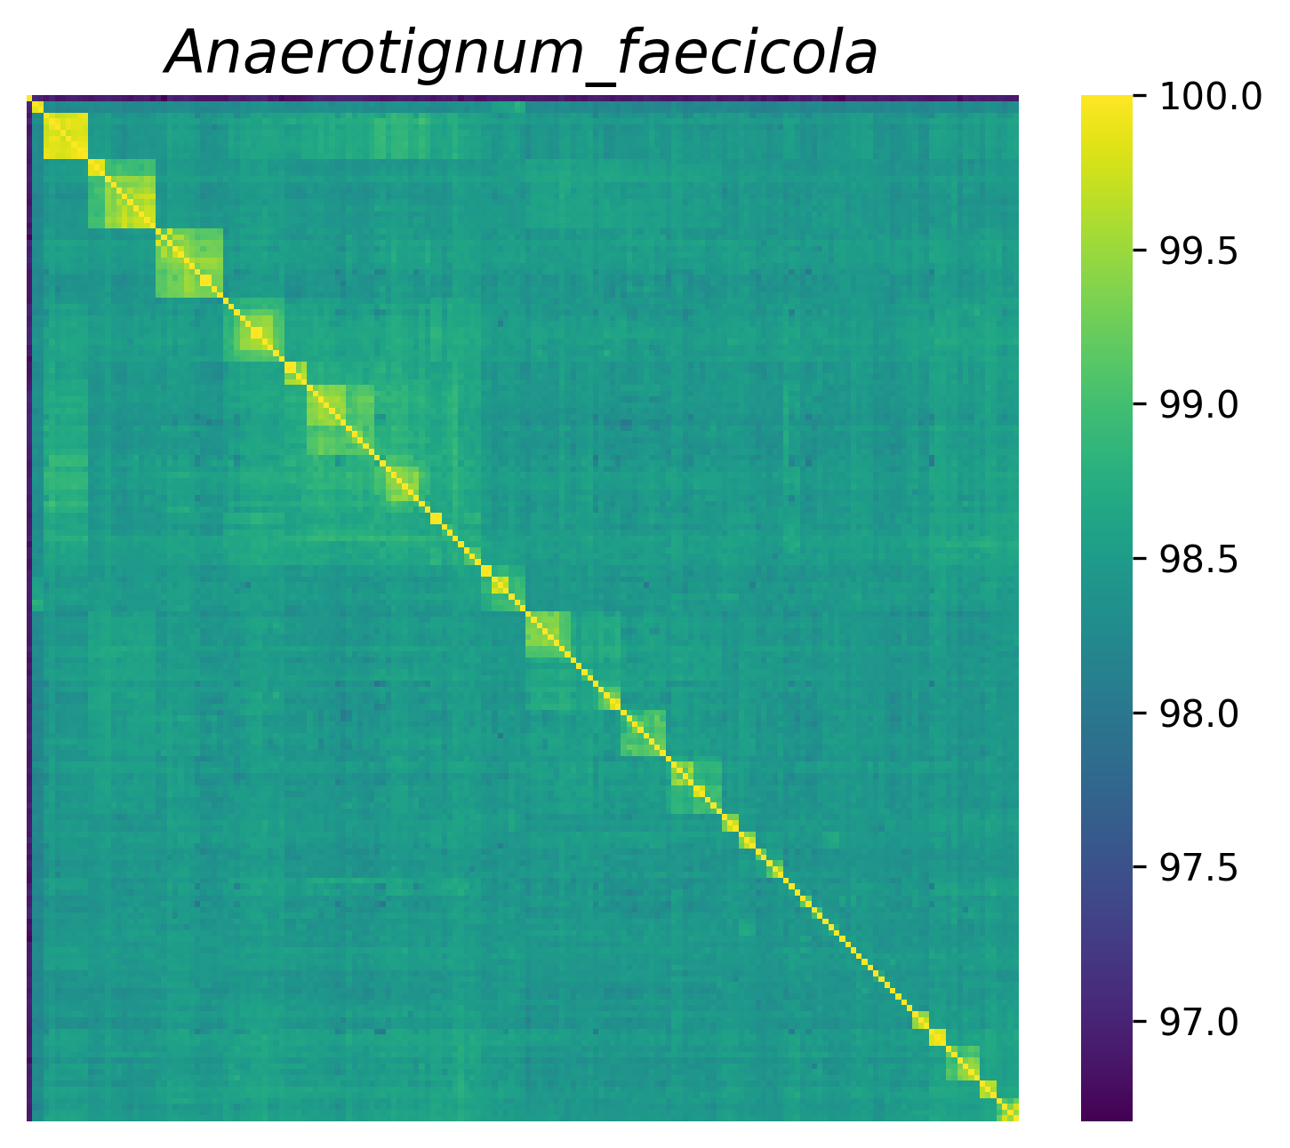
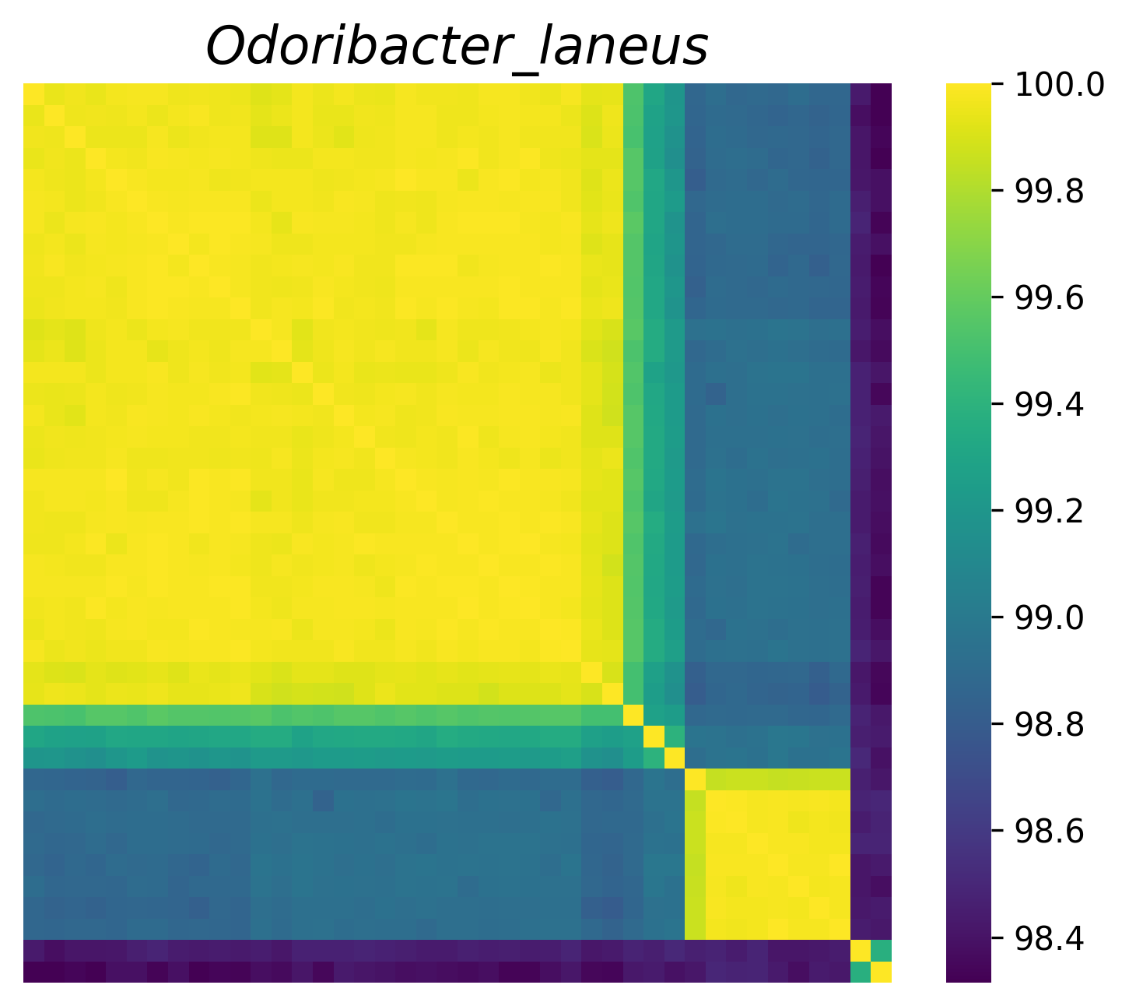
When species is just not enough
Bacteria with
genome similarity > 95%
are different species

Slide 8
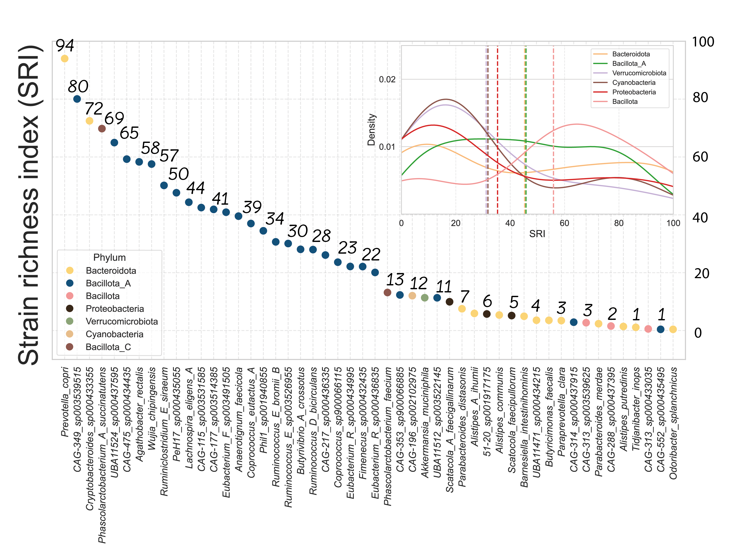
The Strain Richness Index - SRI
The Strain Richness Index (SRI) expresses the level
of genetic diversity within a species by quantifying
the number of distinct strains present in a given
population or sample set.
SRI=94 means that per each 100 genomes of particular species we expected 94 different strains
-> Each strain cluster has 1-2 participant

Slide 10
Strain level association study
Volcano plot showing the associations between the two major O. splanchnicus strains and 33 disease phenotypes. The red line indicates the Bonferroni-corrected significance threshold.
Pan-genome analysis of five representative MAGs from each
O. splanchnicus strain (N1 and N2).
Principal coordinates analysis (PCoA) of O. splanchnicus representative MAGs based on predicted gene cluster presence/absence profiles.

Slide 11
Thoughts
Not all species may be suitable for strain-level analysis
Differences in strain richness need to be further explored using broader global microbiome data
Why are some gut species highly diverse while others are not?

Slide 12

POSTER 20

